Slide 1
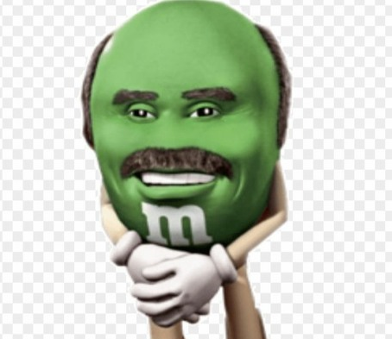
FHICT Pitch
By Johnson Domacasse

Slide 2

Pitch?

Slide 3


Slide 4
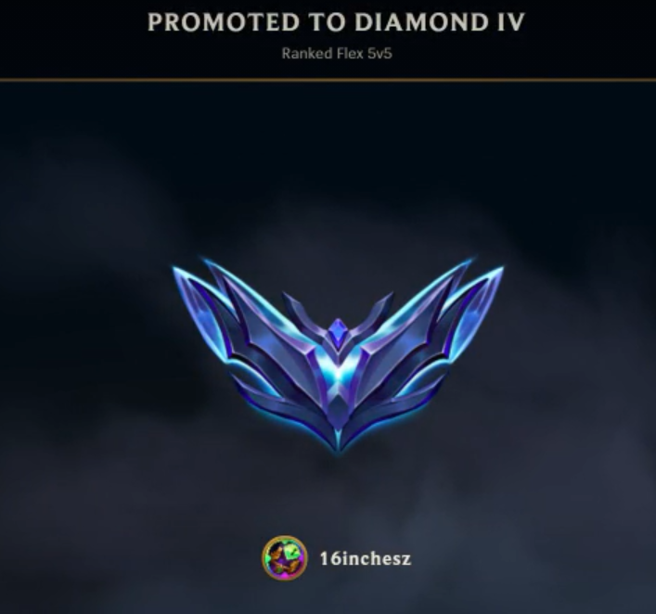
Why should you listen to me?

Slide 5
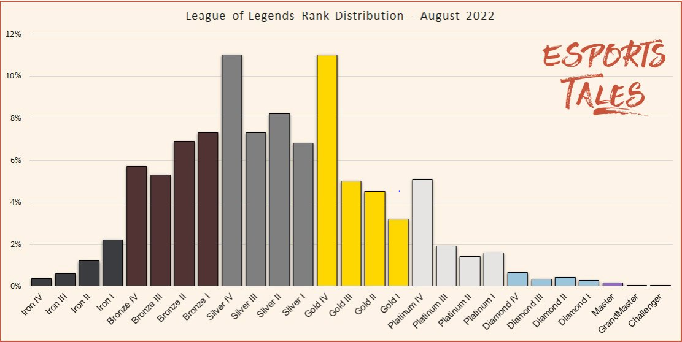
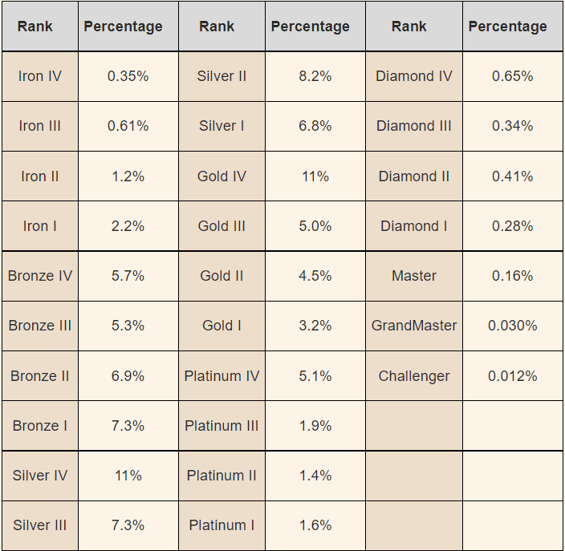
Perspective.
PLAYER BASE IN EUW?

Slide 6
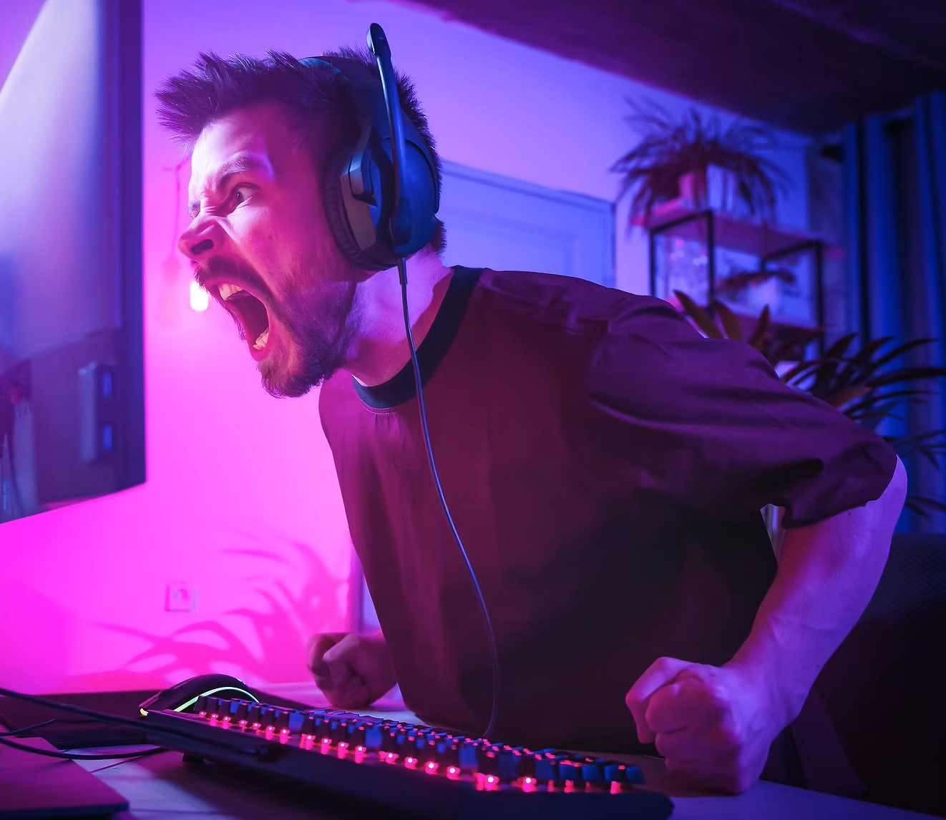
WHY shouldn’t you play League?
CONS
Toxic player Base
Can be addicting
PROS
Fun with friends
Time killer
Competetive

Slide 7
QUESTIONS?

